Slide 1

MATLAB processing techniques for soil moisture and matric potential data
John Shuler
Boise State University
GEOS597
12/5/2016

Slide 2
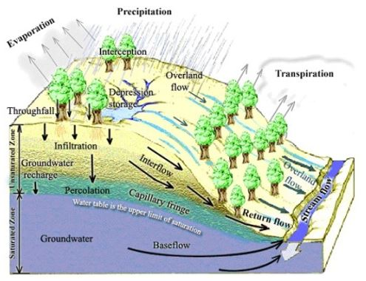
Soil is a main driver of precipitation routing
Notes:
Precipitation falls on the landscape and is partitioned into various fluxes
Soil plays crucial role in nature of these fluxes

Slide 3
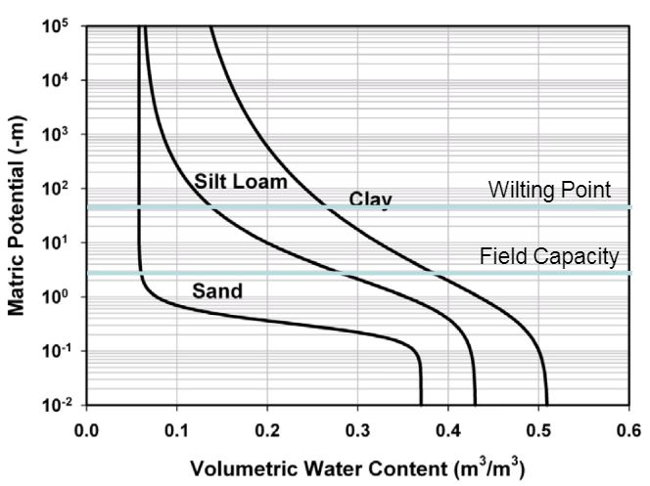
Soil moisture and tension are common parameters of interest
Characteristic curves reveal soil properties
[Hillel, 1998]
Notes:
Units of each
Usually derived in a lab setting; usually some hysteresis
Briefly define field capacity and wilting point

Slide 4
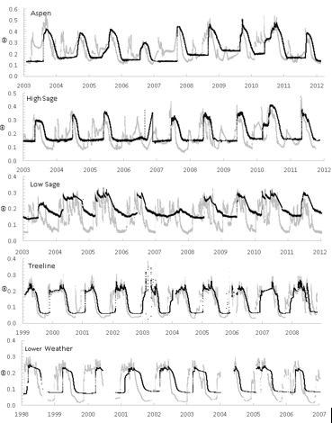
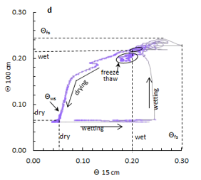
Soil properties can be inferred from in situ time series data
[Chandler et al., 2016]

Slide 5
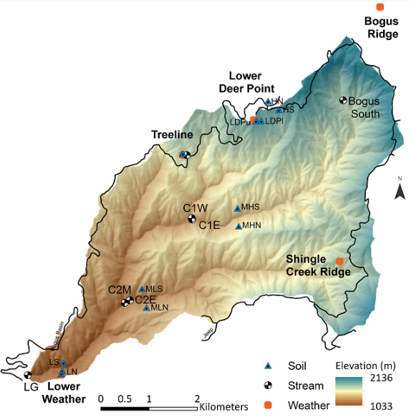
DCEW Study Site and Instrumentation
Data Con 1 East Soil Profile:
5 moisture sensors (also measure temperature)
4 matric potential sensors
Measurements collected every 15 minutes from 5/12/16 to 9/30/2016
Notes:
Briefly explain soil moisture sensors and matric potential sensors here
GET A FIELD SITE CLOSE TO THE ROAD

Slide 6
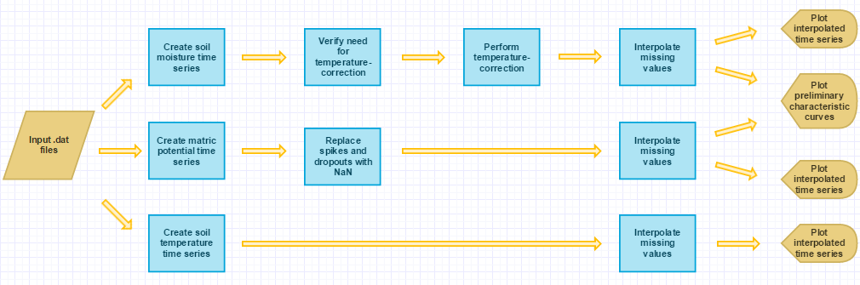
Workflow Chart
Notes:
Note bulk of work takes place during temperature correction

Slide 7
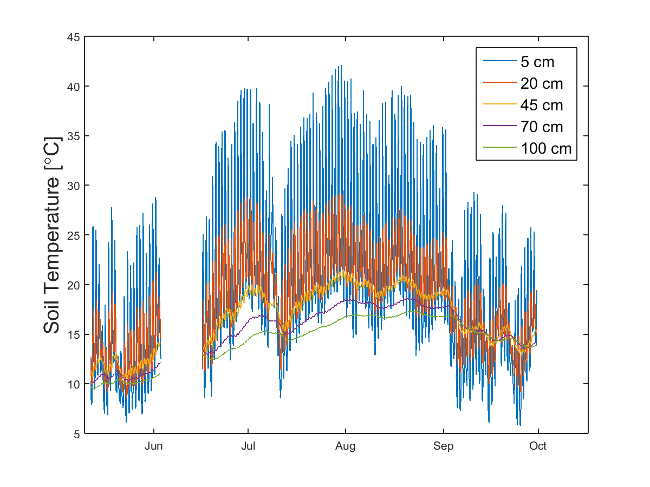
Raw soil temperature data
Issues:
Data gap in early June

Slide 8
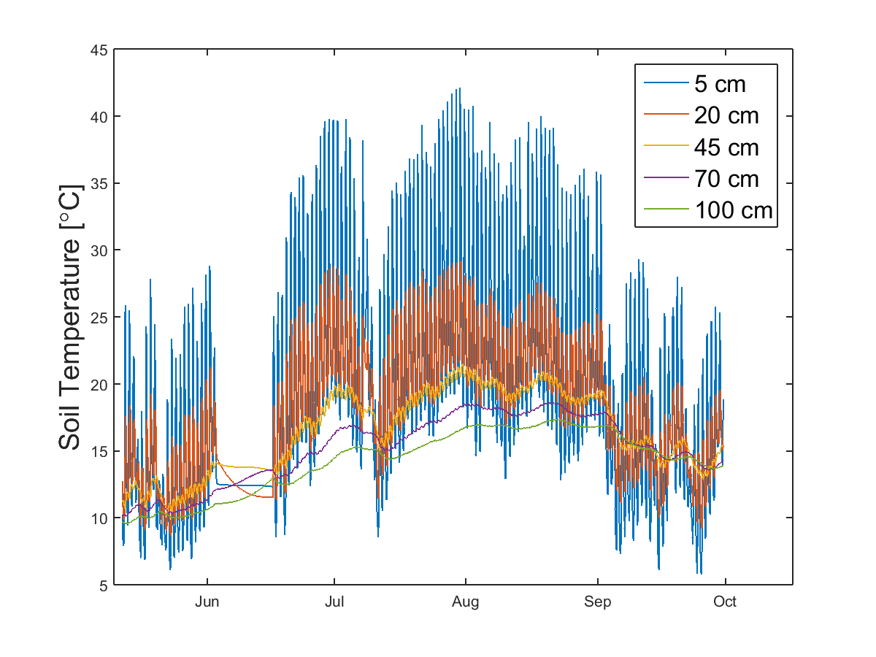

Processed soil temperature time series
Notes:
Good for long term trend, not for analyses where amplitude data is necessary

Slide 9
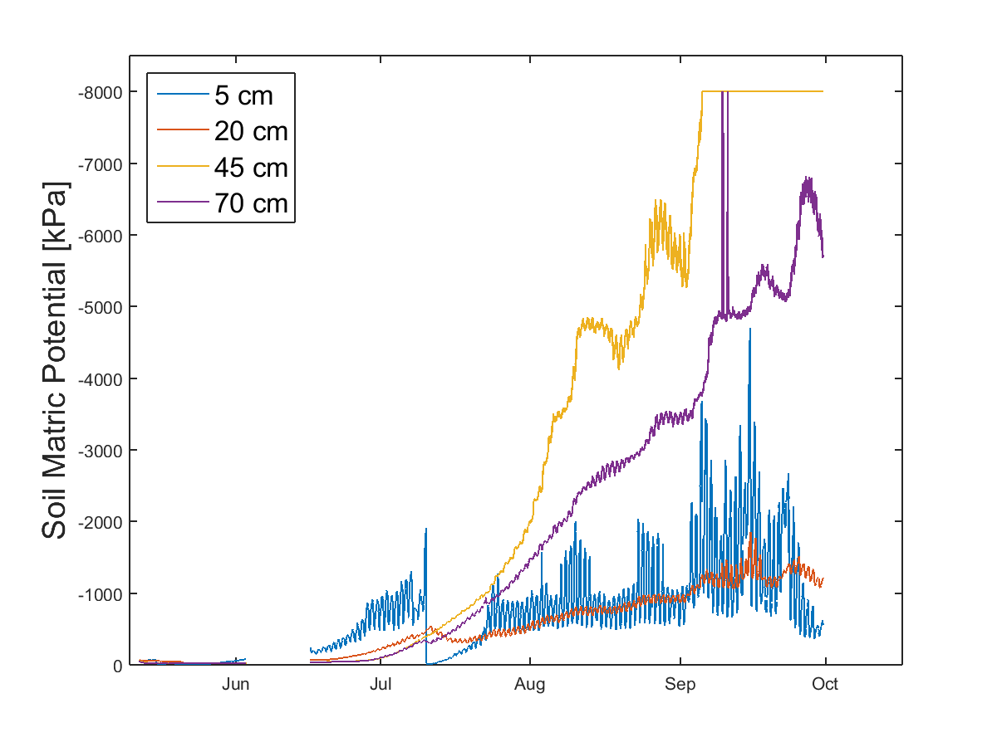
Raw matric potential data
Issues
Spikes and dropouts
Data gap in early June
Diurnal fluctuations

Slide 10
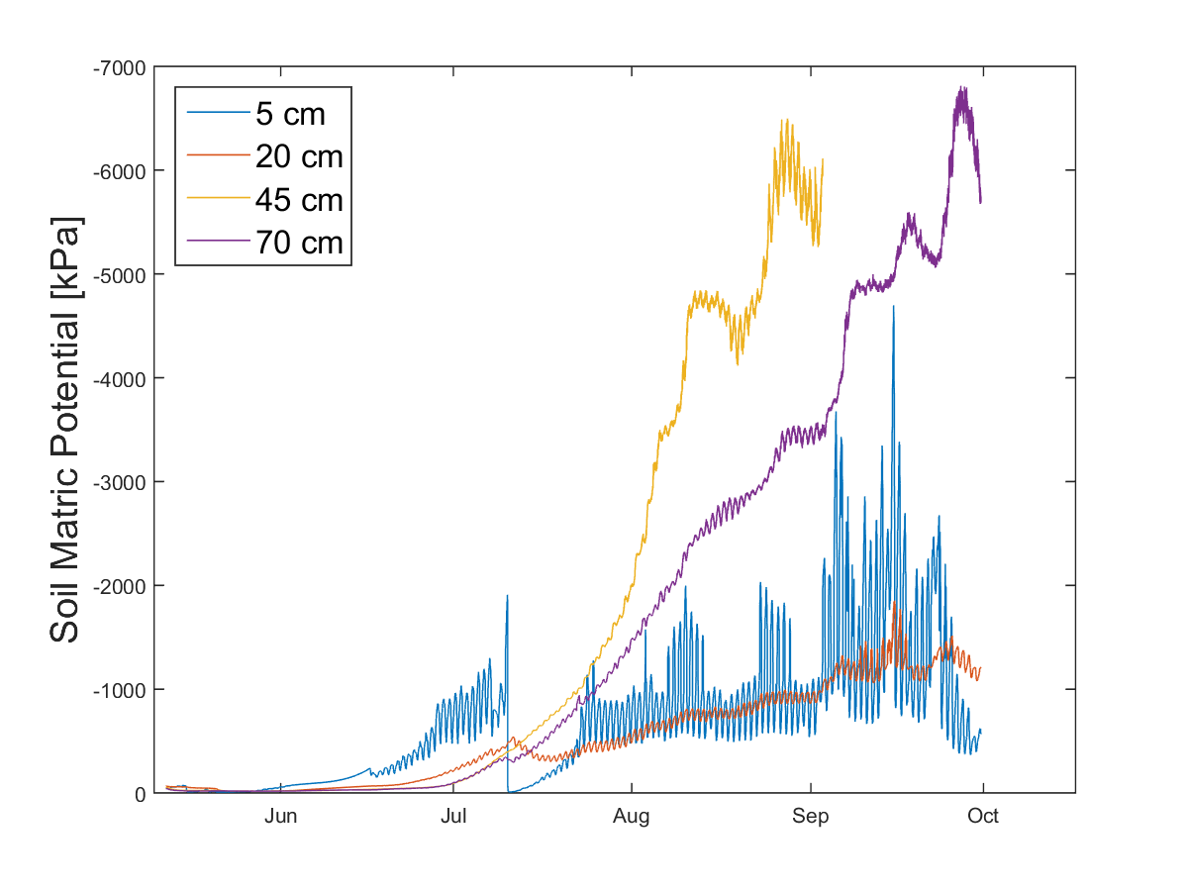

Processed matric potential time series
Processing ignores diurnal fluctuations (for now)
Notes:
Interpolated in similar manner to temp data but over shorter time span for Sensor 3

Slide 11
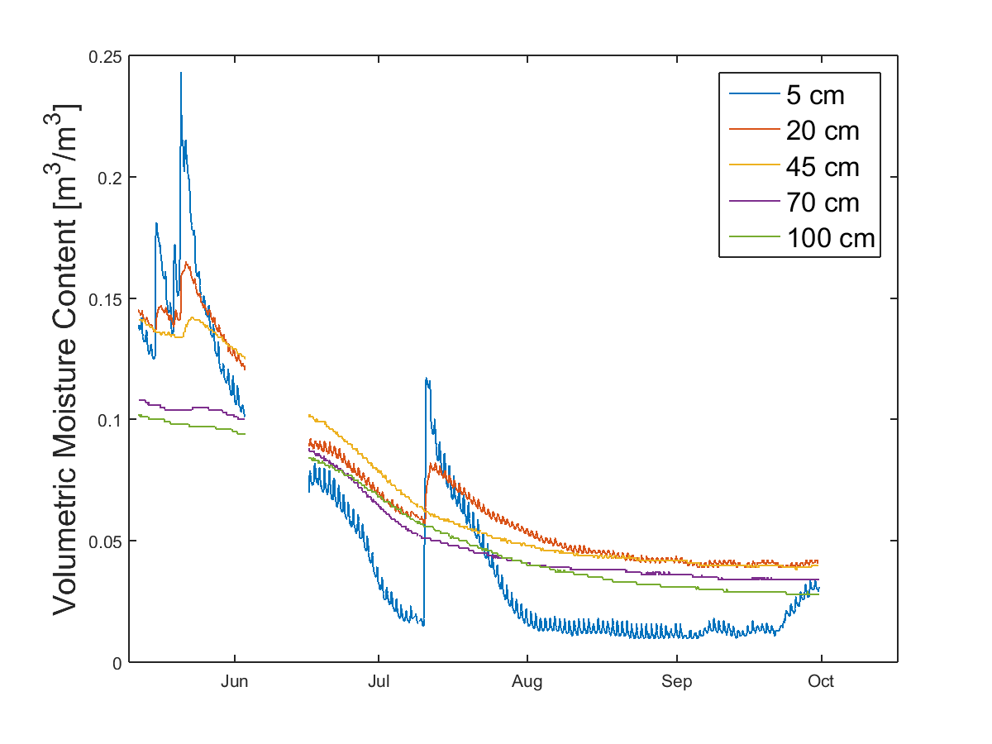
Raw soil moisture data
Issues:
Data gap in early June
Diurnal fluctuations in shallow sensors
Notes:
To assess if fluctuations are truly on a 24-hr period
First must select subset with relatively little trend

Slide 12
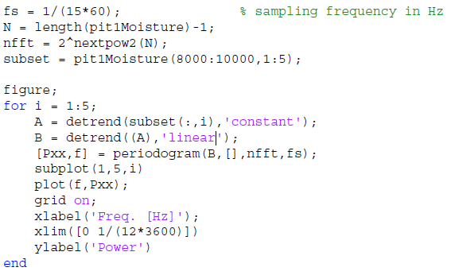
Code for periodogram of data subset

Slide 13
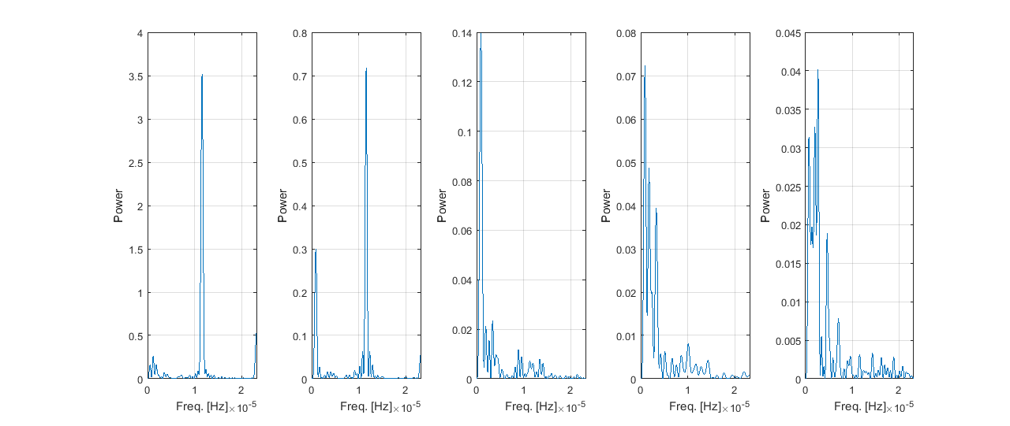
Is temperature-correction of VMC data justified by periodicity?

Slide 14
Temperature correction a la Cobbs and Campbell, 2007
Method requires manual selection of 3 rain-free, 24-hour periods
Temperature correction equation uses multiple linear regression
Coefficients for MLR produced by the Matlab regress() function:

Slide 15
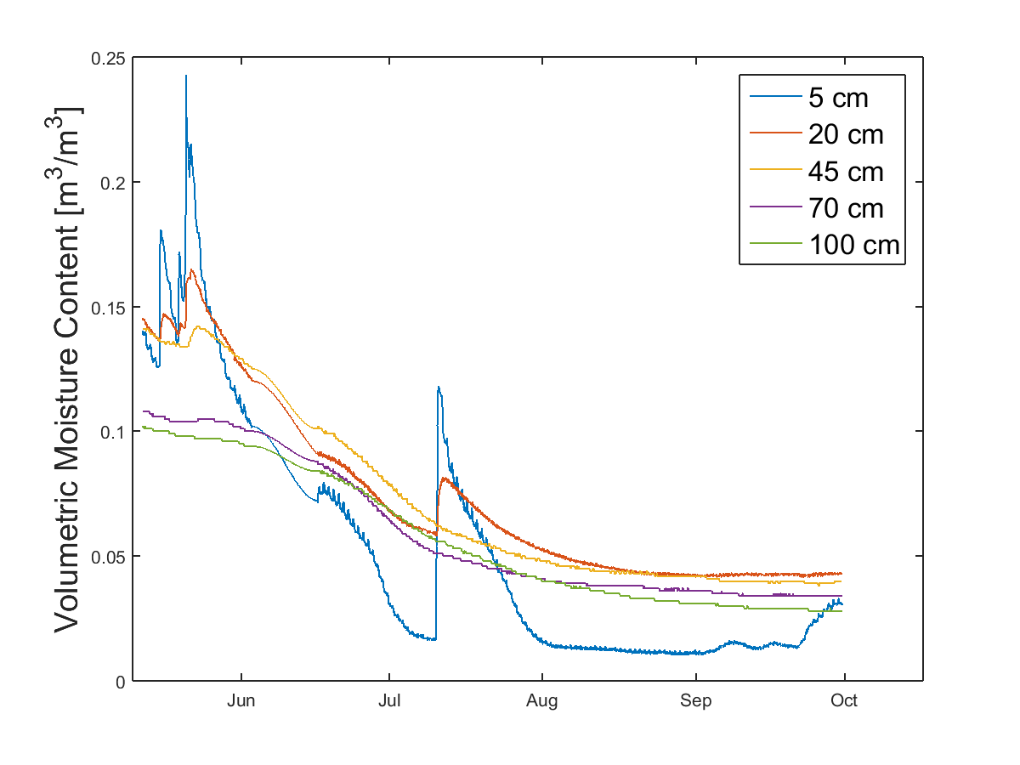
Processed soil moisture data

Slide 16
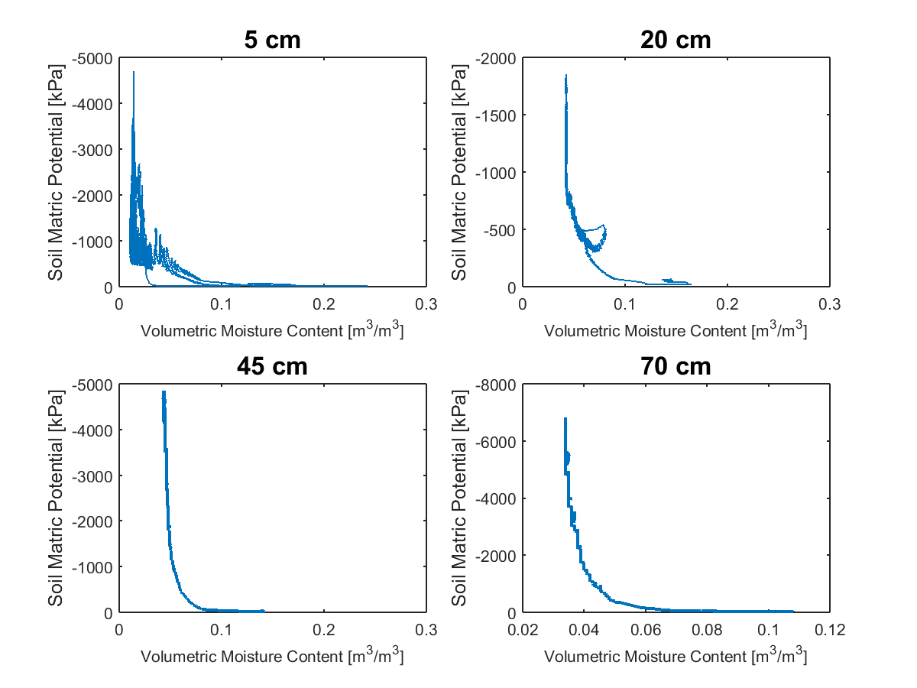
Incomplete Characteristic Curves

Slide 17
To-Do List for Future John
Continue data collection to improve characteristic curves
Explore periodicity of matric potential data
Use low-pass filter to correct for temperature?
Relate moisture and matric potential to stable isotope data

Slide 18
References
Chandler, D., M. Seyfried, J. McNamara (2016), Inference of Soil Hydrologic Parameters from Electronic Soil Moisture Records. In review for Hydrologic Processes
Cobos, D. and C. Campbell, (2007) Correcting temperature sensitivity of ECH2O soil moisture sensors, Decagon Devices, Pullman, WA
Hillel, D. (1998) Environmental Soil Physics: Fundamentals, Applications, and Environmental Considerations, 1st Edition, Academic Press, Cambridge, MA
Lu, M., J. Kapilaratne and I. Kaihotsu (2015), A data-driven method to remove temperature effects in TDR-measured soil water content at a Mongolian site. Hydrological Research Letters, 9(1), 8–13 DOI: 10.3178/hrl.9.8

